Slide 1



AE-based Kernel ICA: Non-linear blind source separation
Christian Reimers
Benedikt Heidrich
Xavier-Andoni Tibau Alberdi
Everyone contribute equally to this work

Slide 2
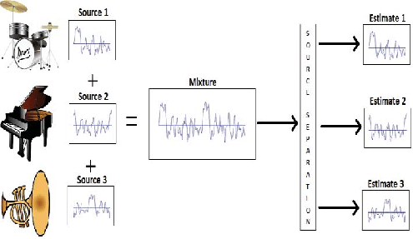
Tahir 2015

Slide 3
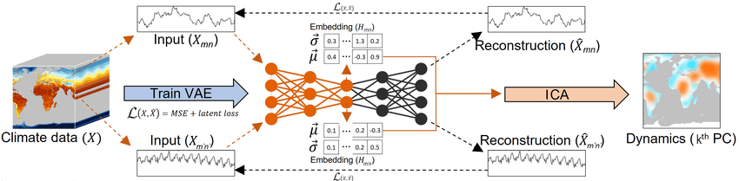

Slide 4
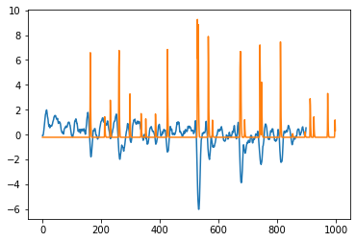
FastICA 32 AE
Corr: -0.4978

Slide 5
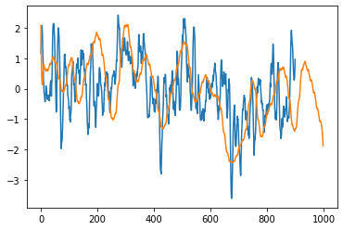
FASTICA 32 AE
Corr: 0.4186

Slide 6
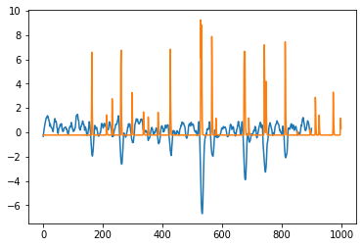
FastICA 32 AE
FastICA 32 AE Equator
Corr: -0.4978
Corr: -0.5677

Slide 7
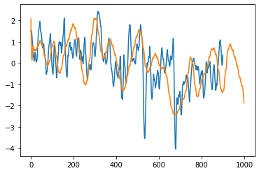
FASTICA 32 AE
FASTICA 32 AE SOUTH POLE
Corr: 0.4186
Corr: 0.4927

Slide 8
Future Work
* Check results on the second time series
* Find a better AE arquitecture
* Use Beta-VAE for kernel approximation
* Use other climate model data (CMIP6)
* Consider time for AE (3D conv?)

